Slide 1
MOBILE COMPUTING
Delhi Open transit App
Submitted by:-
Rijit singh - MT23073
Pulkit Rihani - MT23066
Vanshaj Sharma - MT23103
Ayush giri Goswami - MT23113

Slide 2

Content
Problem statement
Flow of the app
Database creation
Features implemented
App Ui
Logic behind distance
Library used
Assumptions

Slide 3

Objective
The aim of this project is to provide users with real-time information about the location of the bus they are traveling on, along with upcoming stops. This app serves as a guide for users unfamiliar with Delhi's bus system.

Slide 4
Overview
The Delhi Open Transit App is a groundbreaking project designed to revolutionize public transportation in Delhi, India, by providing commuters with a seamless
and efficient way to navigate the city's bus network. Developed using Kotlin, a modern programming language for Android app development, the app offers a user-friendly interface and innovative features to enhance the commuting experience.
Real-time Bus Tracking
User Interaction
Location-Based Services
To and From Stops
Route Information

Slide 5
Flow
First, the application prompts users to indicate if they are currently traveling.
If the response is affirmative, it directs users to a screen where they can input the bus route number. Utilizing GeoFusion, the app retrieves real-time information about the ongoing bus stop based on the bus's location and the user's coordinates.
Alternatively, if the user responds negatively, the app presents another screen where users can input the source and destination bus stops. From a pool of 4000 buses, the app filters the buses that serve these stops and displays their route numbers. Upon selecting a bus, users are redirected to a screen showing all the stops along the selected bus route.

Slide 6
Scope
The Delhi Open Transit App for tracking buses is a project aimed at enhancing public transportation services within the city of Delhi, India. The scope of this project encompasses the development of a mobile application that enables commuters to track the real-time location and arrival times of buses operating across different routes within the city.
Real-Time Bus Tracking
Route Planning
Bus Schedule Information
Integration with Other Services

Slide 7
User Interface
Splash Screen: Introduces the app.
Home Screen:Central hub of the app.
Yes/No Screen: Asks if the user is currently traveling.
Live Location Screen:Shows live bus location and upcoming stops.
Bus Selection Screen: Displays available buses based on source and destination stops.
Route Stops Screen: Lists all stops for the selected bus route.

Slide 8

Splash Screen

Slide 9
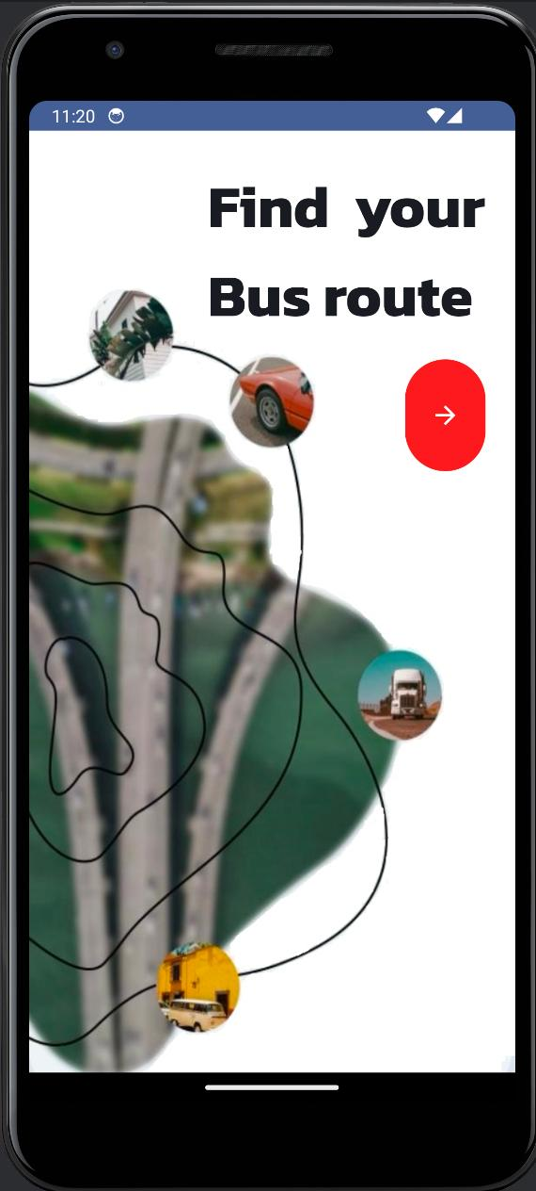
Home Screen

Slide 10
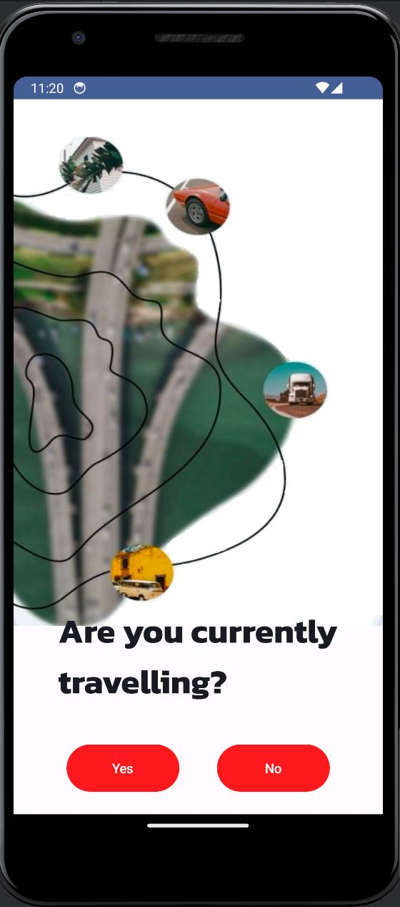
Yes/No Screen

Slide 11
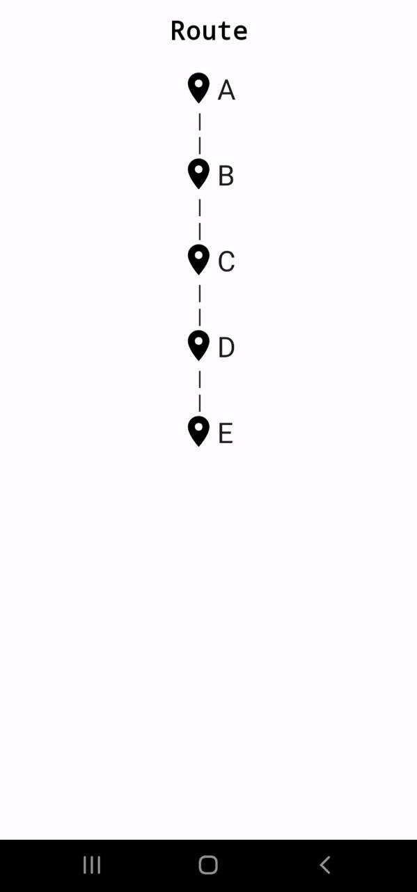
Live Location Screen

Slide 12
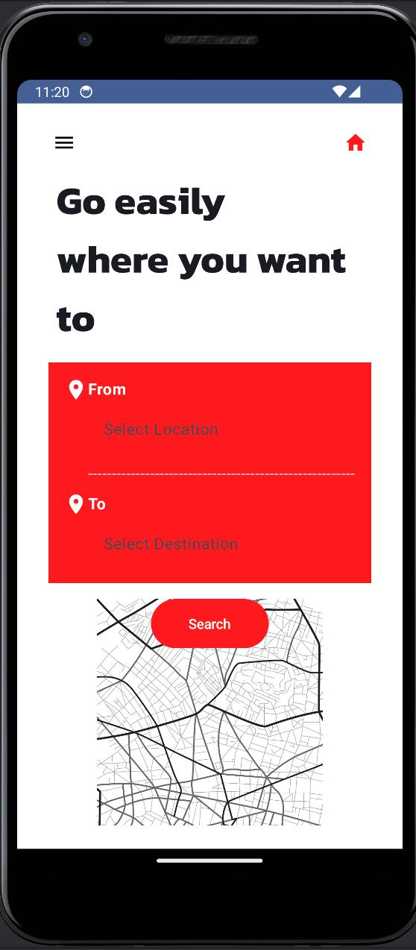
Bus Selection Screen

Slide 13
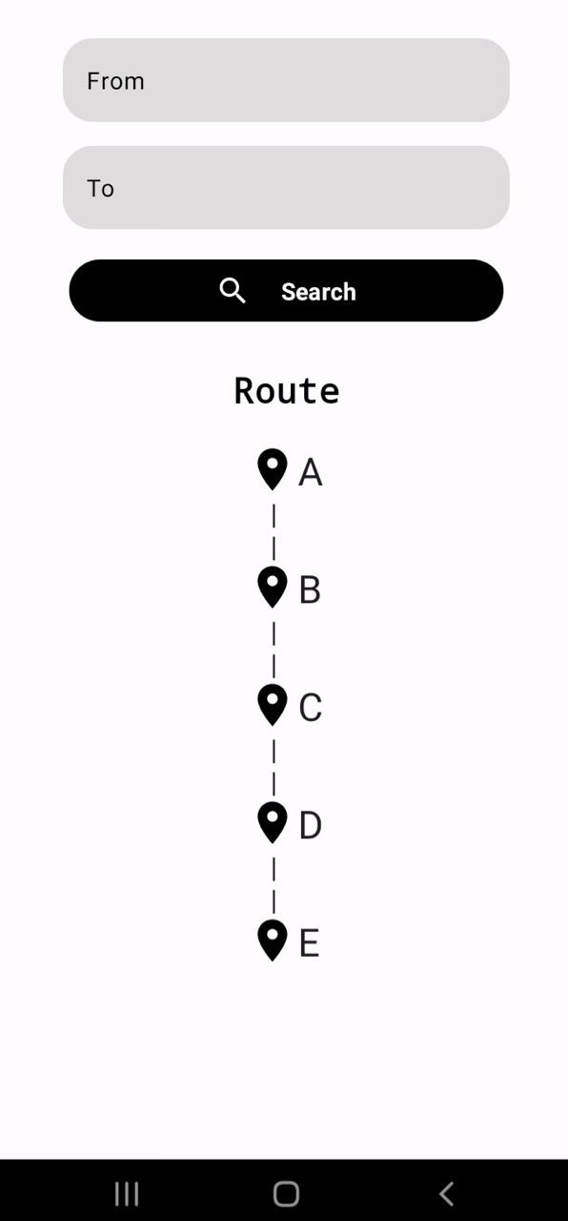
Route Stops Screen

Slide 14

Main Features
Live bus location tracking.
Information about upcoming bus stops.
Notification when the destination is approaching.

Slide 15
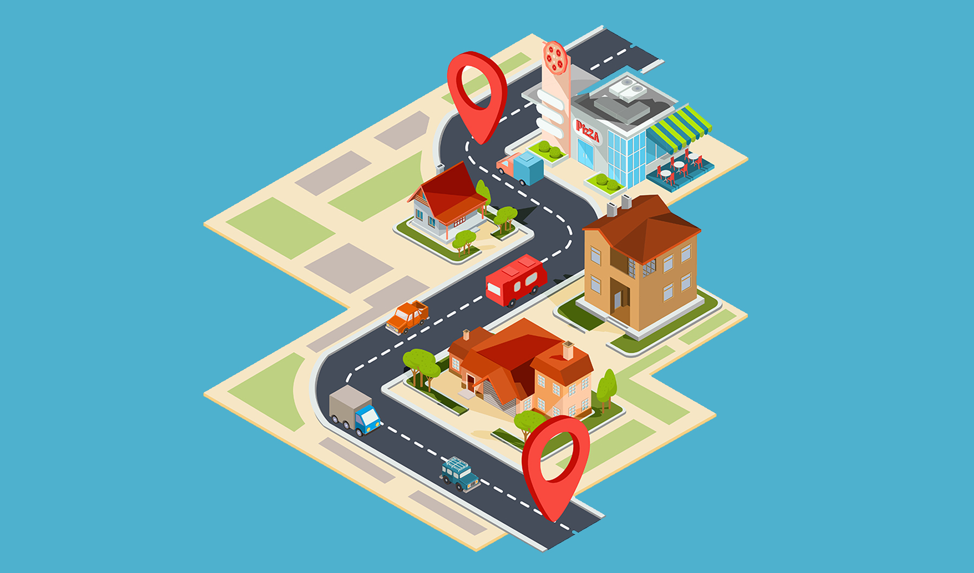

Sensor
fusedLocation
The Delhi Open Transit App leverages the Fused Location Provider API, a part of Google Play services, to obtain accurate and up-to-date location information from various sources such as Wi-Fi and cellular networks. This integration ensures that users receive precise location data, enabling the app to deliver real-time bus tracking and personalized route planning features effectively.

Slide 16

Formula Used
Euclidean Distance formula for calculating distance between bus stops and user location:
distance = sqrt((x2 - x1)^2 + (y2 - y1)^2)

Slide 17

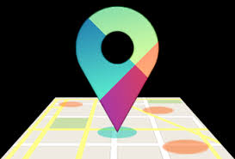
Libraries Used
GeoFusion
Google Play Maps API

Slide 18

Database
SQLite
Database created using Open Transit Delhi API maintained by IIITD.

Slide 19


Database Creation
A Python script was used to extract data from the protocol buffer file provided by the API.

Slide 20

Assumptions
Utilizing static data from the Delhi Open Transit website.
Assumes users know the source and destination bus stops.
Assumes direct bus routes without interchanges.
Assumes users know how to reach the source bus stand.

Slide 21

Conclusion
This project bridges the gap for users unfamiliar with Delhi's bus system, providing them with essential real-time information for a smoother travel experience.

Slide 22
Thank You

